Slide 1

Join Operator Internals
Notes:
Today we are going to be talking about Join Operator internals.
I like learning SQL Server internals because I like to know how things work.
Especially important because then I don’t need to memorize things, I can just figure out what something is if I know how it works.
Important because they can reveal a lot about how your query works – it allows you to make assumptions about your data based on what operator SQL Server chose.
-Another tool you can use for understanding the performance ofyour execution plans

Slide 2
Disclaimer
This presentation focuses on inner joins
Assumes equality comparisons
Some of these visualizations are simplified
Notes:
There are lots of different join times, inner, outer, left, right, cross joins, cross applys, etc…
This covers the most common case, the rest can be relatively figured out using these assumptions
It’d be a really boring presentation to go through computer sorting algorithms that arenn’t visual in my opinion.
If you do want that detail, you can go read lots of research papers from the 1970s.
Not specific to SQL Server, but these algorithms are common through all of programming – so if you have a background, you may recognize some of them

Slide 3
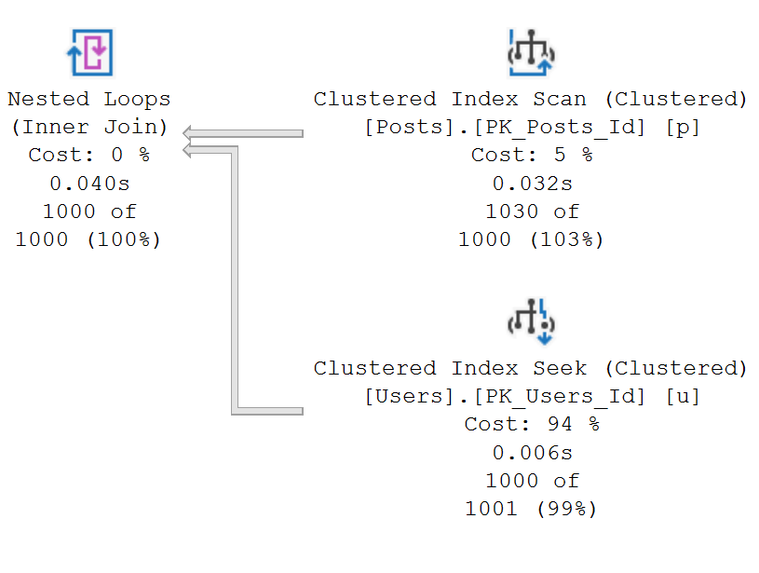
Nested Loops
Notes:
Nested Loops Joins Considerations
CPU intensive - SQL Server thinks one of the inputs is relatively small
If you see upstream are *not* small, may indicate estimation problems
RID/Key lookups - frequently seen together because SQL Server will only use a lookup if it thinks small number of rows to lookup
Worth checking for a column missing from the main index
Might indicate SELECT * being used somewhere (like in a subquery)

Slide 4

Nested Loops Join
Notes:
Nested Loops Joins Considerations
CPU intensive - SQL Server thinks one of the inputs is relatively small
If you see upstream are *not* small, may indicate estimation problems
RID/Key lookups - frequently seen together because SQL Server will only use a lookup if it thinks small number of rows to lookup
Worth checking for a column missing from the main index
Might indicate SELECT * being used somewhere (like in a subquery)

Slide 5

Nested Loops Join – Indexed
Notes:
Nested Loops Joins Considerations
CPU intensive - SQL Server thinks one of the inputs is relatively small
If you see upstream are *not* small, may indicate estimation problems
RID/Key lookups - frequently seen together because SQL Server will only use a lookup if it thinks small number of rows to lookup
Worth checking for a column missing from the main index
Might indicate SELECT * being used somewhere (like in a subquery)

Slide 6
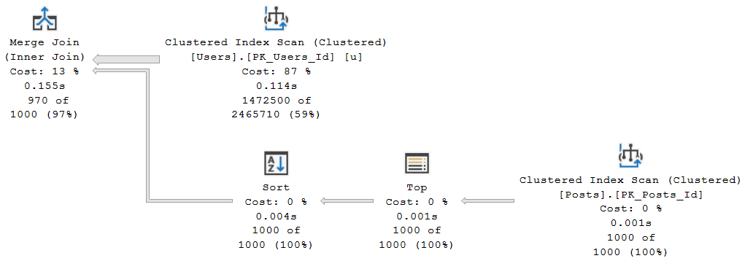
Merge
Notes:
Merge Joins Considerations
- The fastest join type, barring any optimizations of other join types, but require sorted data
- If SQL Server doesn't know your columns aren't unique, it is forced to use a worktable to dedupe using a peek-ahead buffer
- SQL Server optimizer is fairly pessimisstic about merge join calculations, so if you see a merge join it's probably a good thing
- Data going into a Merge Join has to be sorted - worth double checking to see if this is coming from an index or if SQL is doing some type of expensive sort due to transformations
- Might be able to move column from Include to Key of index with minimal space difference but better performance
- If you know you have lots of duplicate data, worth testing other join types because those duplciate values are forced to tempdb.
- Nested loops joins might be faster in this case

Slide 7

Merge Join
Notes:
Merge Joins Considerations
- The fastest join type, barring any optimizations of other join types, but require sorted data
- If SQL Server doesn't know your columns aren't unique, it is forced to use a worktable to dedupe using a peek-ahead buffer
- SQL Server optimizer is fairly pessimisstic about merge join calculations, so if you see a merge join it's probably a good thing
- Data going into a Merge Join has to be sorted - worth double checking to see if this is coming from an index or if SQL is doing some type of expensive sort due to transformations
- Might be able to move column from Include to Key of index with minimal space difference but better performance
- If you know you have lots of duplicate data, worth testing other join types because those duplciate values are forced to tempdb.
- Nested loops joins might be faster in this case

Slide 8
Merge Join – Non-unique
Notes:
Merge Joins Considerations
- The fastest join type, barring any optimizations of other join types, but require sorted data
- If SQL Server doesn't know your columns aren't unique, it is forced to use a worktable to dedupe using a peek-ahead buffer
- SQL Server optimizer is fairly pessimisstic about merge join calculations, so if you see a merge join it's probably a good thing
- Data going into a Merge Join has to be sorted - worth double checking to see if this is coming from an index or if SQL is doing some type of expensive sort due to transformations
- Might be able to move column from Include to Key of index with minimal space difference but better performance
- If you know you have lots of duplicate data, worth testing other join types because those duplciate values are forced to tempdb.
- Nested loops joins might be faster in this case

Slide 9
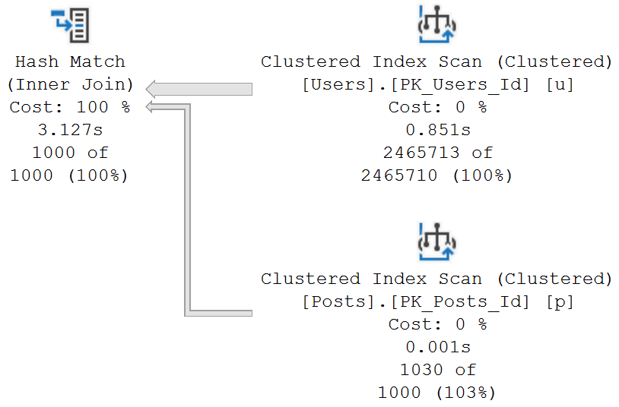
Hash Match
Notes:
Hash Match Joins Considerations
- Workhorse. Nested loops fail if data can't fit into memory, Merge joins require pre-sorted data, Hash Joins just don't care (assuming you have enough disk space in tempdb).
- Usually only 1 row per hash bucket
- Works on equality operators only (because can't compare a hash)
- When SQL Server can't fit the build table in memory, it spills to tempdb and processes little bits at a time.
- Hash is a blocking join. Typically if I see them I want to see if there's soemthing I can do to change them.
- Hash means SQL Server upstream rows are big. Can we get them to reduce earlier on (sometimes query plan doesn't filter rows until after join...need to fix statistics/estiamtes or use some trick to filter data out first before joining)
- Hash in memory is pretty fast. Hash spilling to tempdb is bad. wroth checking why: if really big data, not much you can do.
- But if the memory grant looks unusually small, probably means we have another statistics problem that is providing SQL Server optimizer estiamtes that are too low.

Slide 10

Hash Match Join
Notes:
Hash Match Joins Considerations
- Workhorse. Nested loops fail if data can't fit into memory, Merge joins require pre-sorted data, Hash Joins just don't care (assuming you have enough disk space in tempdb).
- Usually only 1 row per hash bucket
- Works on equality operators only (because can't compare a hash)
- When SQL Server can't fit the build table in memory, it spills to tempdb and processes little bits at a time.
- Hash is a blocking join. Typically if I see them I want to see if there's soemthing I can do to change them.
- Hash means SQL Server upstream rows are big. Can we get them to reduce earlier on (sometimes query plan doesn't filter rows until after join...need to fix statistics/estiamtes or use some trick to filter data out first before joining)
- Hash in memory is pretty fast. Hash spilling to tempdb is bad. wroth checking why: if really big data, not much you can do.
- But if the memory grant looks unusually small, probably means we have another statistics problem that is providing SQL Server optimizer estiamtes that are too low.

Slide 11
Hash Match Join – Spill to tempdb
Notes:
Hash Match Joins Considerations
- Workhorse. Nested loops fail if data can't fit into memory, Merge joins require pre-sorted data, Hash Joins just don't care (assuming you have enough disk space in tempdb).
- Usually only 1 row per hash bucket
- Works on equality operators only (because can't compare a hash)
- When SQL Server can't fit the build table in memory, it spills to tempdb and processes little bits at a time.
- Hash is a blocking join. Typically if I see them I want to see if there's soemthing I can do to change them.
- Hash means SQL Server upstream rows are big. Can we get them to reduce earlier on (sometimes query plan doesn't filter rows until after join...need to fix statistics/estiamtes or use some trick to filter data out first before joining)
- Hash in memory is pretty fast. Hash spilling to tempdb is bad. wroth checking why: if really big data, not much you can do.
- But if the memory grant looks unusually small, probably means we have another statistics problem that is providing SQL Server optimizer estiamtes that are too low.

Slide 12
Additional Resources
Craig Freedman Nested, Merge, Hash
Hugo Kornelis Nested, Merge, Hash
Bert Wagner Nested, Merge, Hash
These slides available at bertwagner.com/joins

Slide 13





Thank you!
@bertwagner
bertwagner.com
youtube.com/bertwagner
bert@bertwagner.com
New posts and videos every Tuesday!

